Slide 1
CISC 5352- Artificial Intelligence in Fintech Quiz (1)

Slide 2
Single Value Decomposition (SVD)
If a matrix A has a matrix of eigenvectors P that is not invertible, then A does not have an eigen decomposition. However, if A is an m × n real matrix with m > n, then A can be written in the SVD form as: A = UDV^{T} where D is rxr diagonal matrix. The diagonal values are called singular values of A and are in a decreasing order with the biggest on the top. U is m × r column-orthogonal matrix. The columns of U are called the left singular vectors for corresponding singular values and V is n × r column-orthogonal matrix. The columns of V are called the right singular vectors for corresponding singular values.
For a complex matrix A, the SVD is a decomposition into the form
A = UDV^{H}
where U and V are unitary matrices, V^{H} is the conjugate transpose of V, and D is a diagonal matrix whose elements are the singular values of the original matrix. If A is a complex matrix, then there always exists such a decomposition with positive singular values

Slide 3
Use of SVD in finance
SVD can represent a high-dimensional matrix into a low-dimensional by eliminating the less important parts and produce an approximate representation with any desired number of dimensions (rank). The best way to reduce the dimensionality of the three matrices is to set the smallest singular values to zero. The fewer dimensions we choose, the less accurate will the approximation be.
Uses- Since SVD is a technique to decompose data
It can be used to find the Variance Concentration Ratio, which is an indication of the outliers (VCR > 3 indicates a lot of outliers)
It can be used to sort the most significant features and rank them

Slide 4
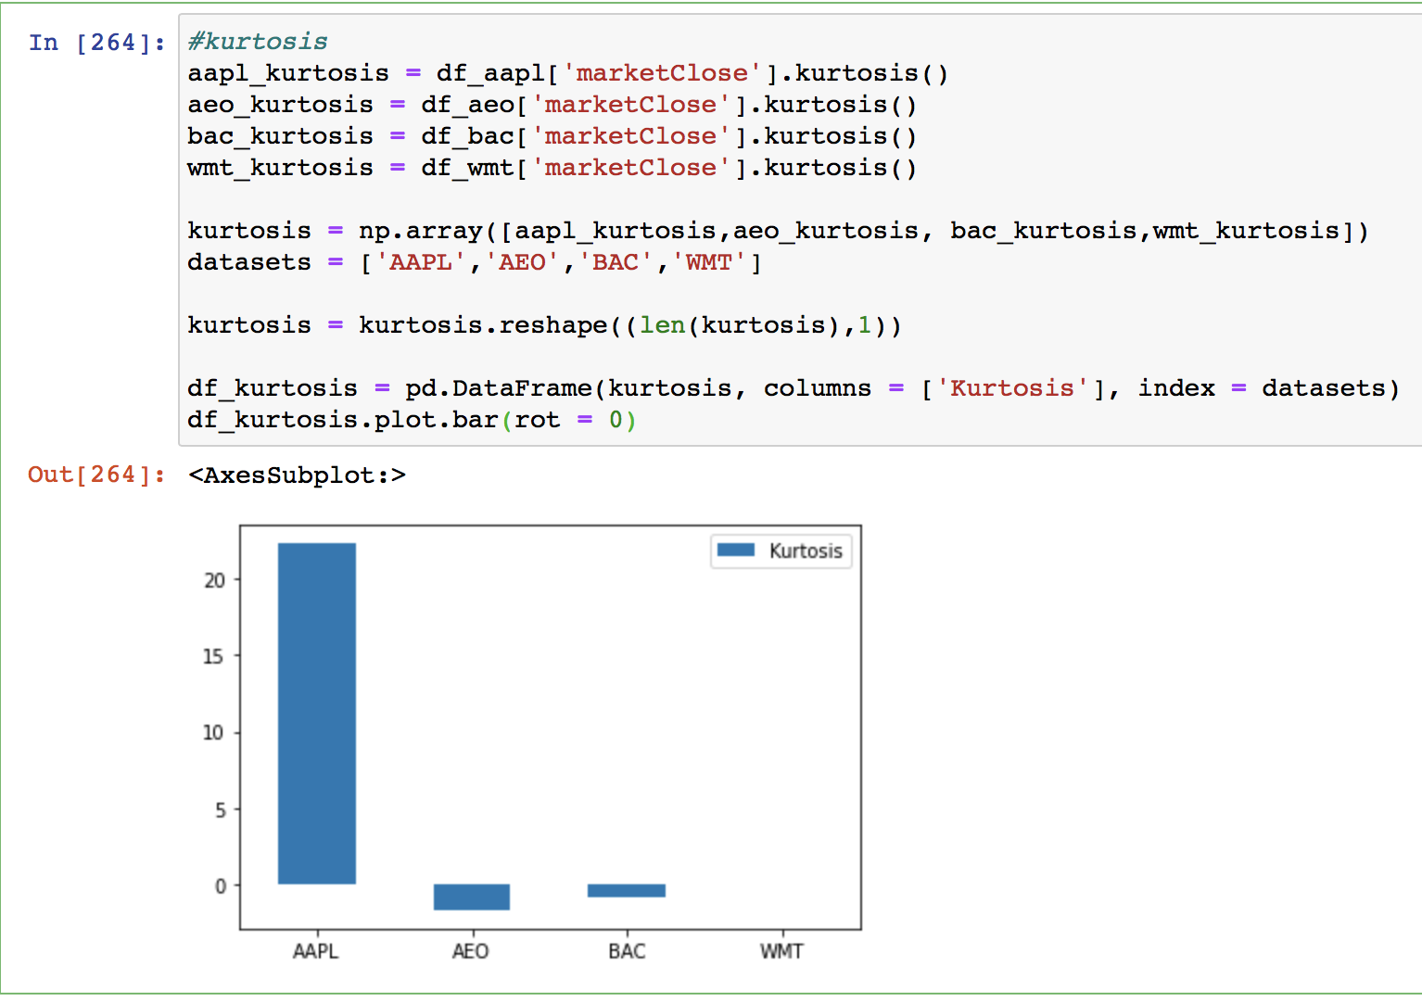
Kurtosis
The AAPL dataset has a high Kurtosis (>3)
Indicating it will have a high number of outliers

Slide 5
Methods of Visualization
PCA
TSNE
LLE
These methods are visualized by Biplot and DBSCAN both
The blue points are the outliers for both

Slide 6
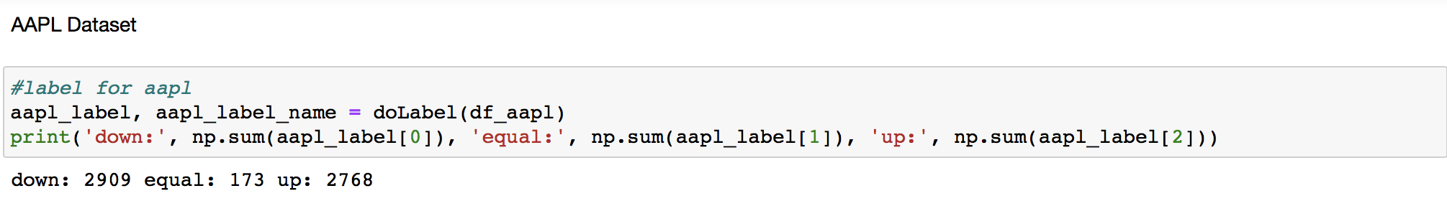
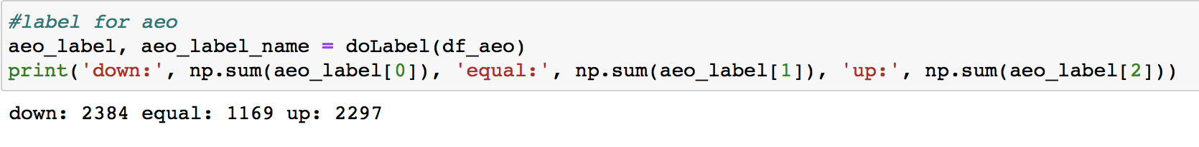
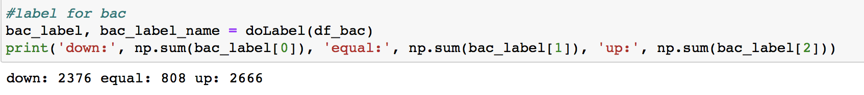
Visualization - Labels for the Biplot

Slide 7
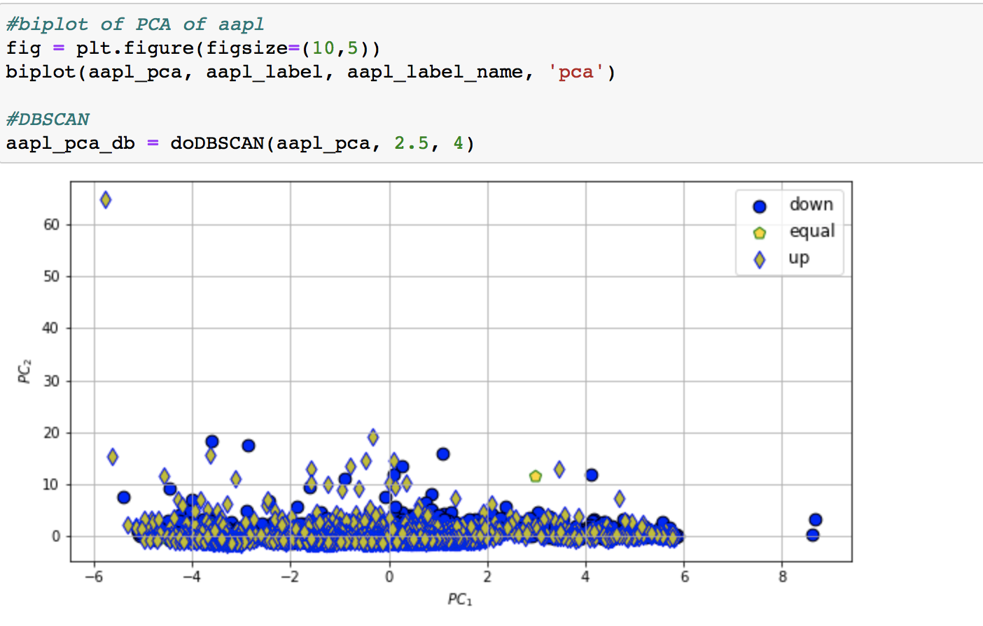
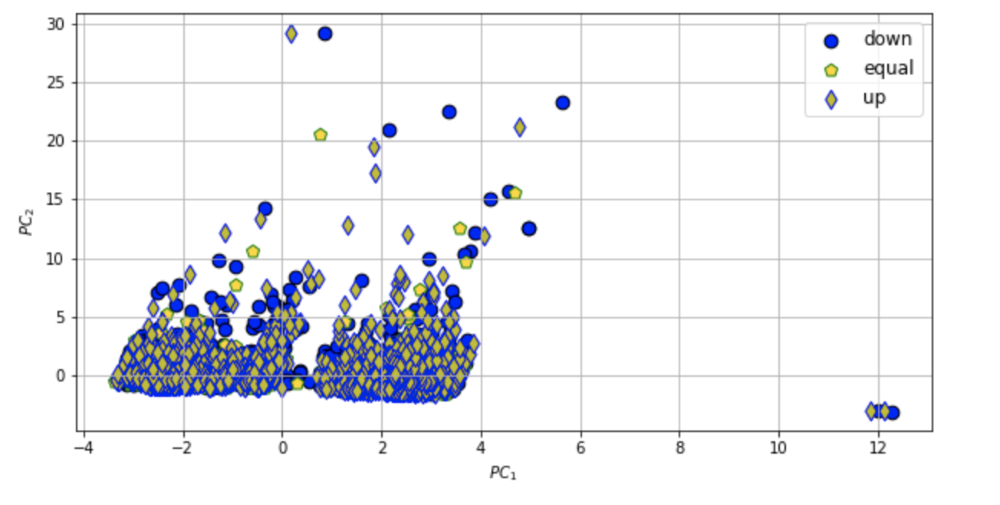
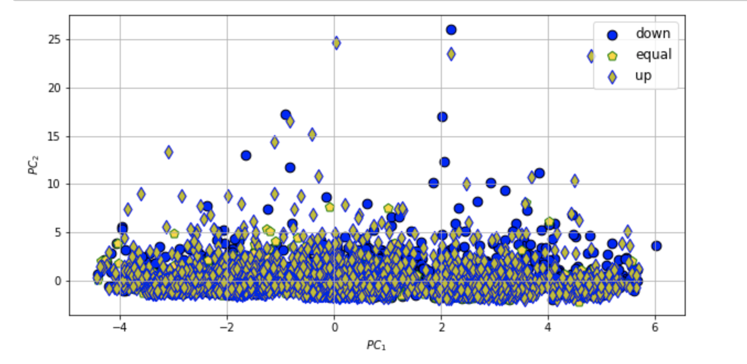
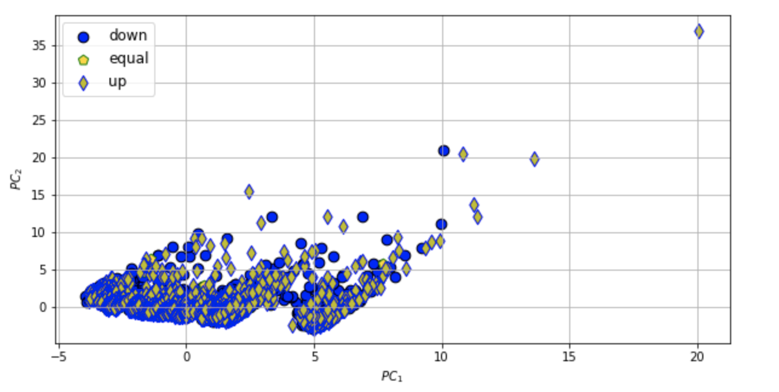
PCA Biplots
Top Left-Right : AAPL, AEO
Bottom Left-Right: BAC, WMT
ATM - shown as equal : marketOpen = marketClose OTM- shown as up : marketOpen < marketClose ITM- down : marketOpen > marketClose

Slide 8
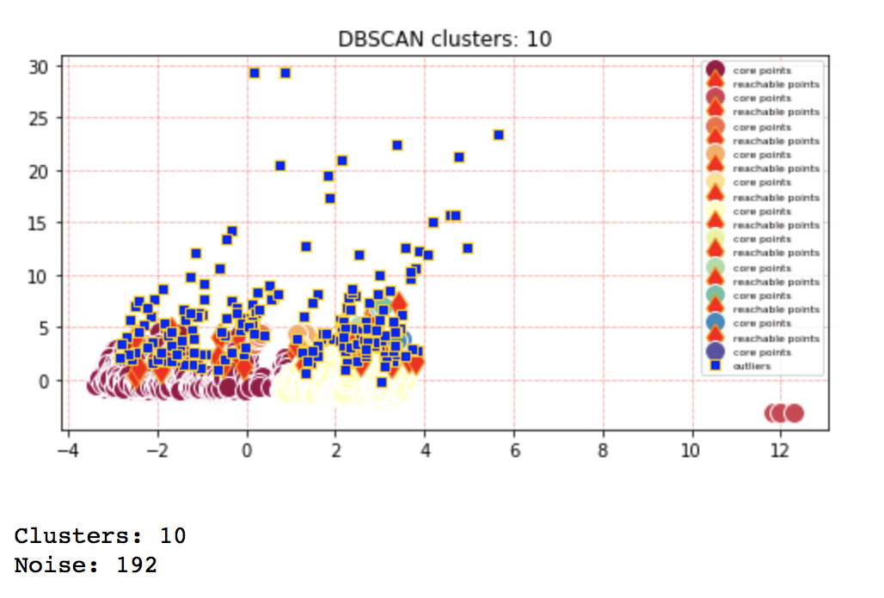
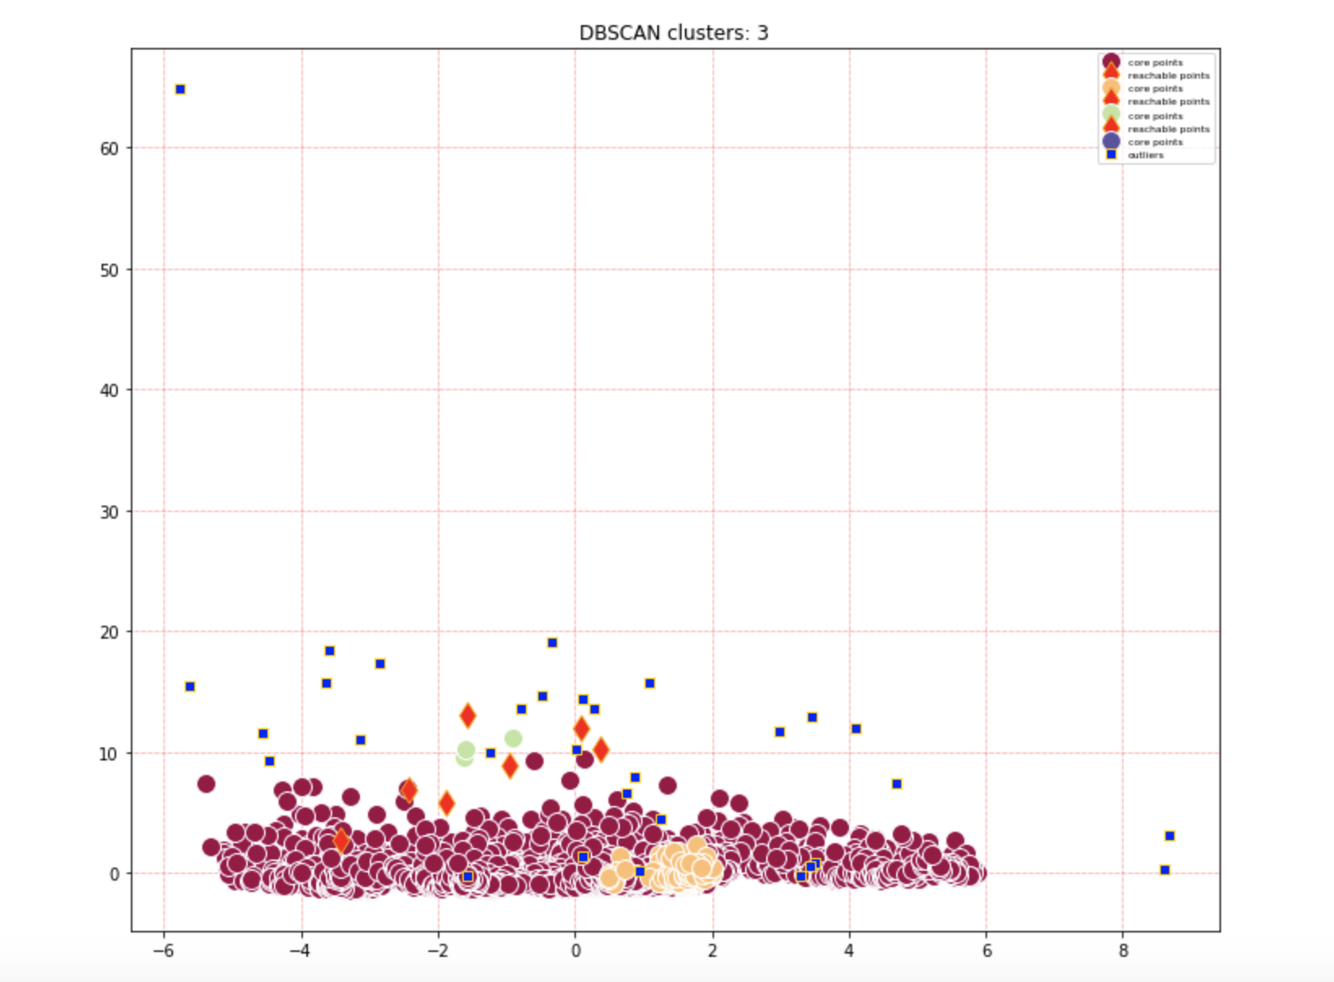
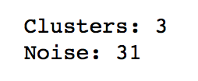
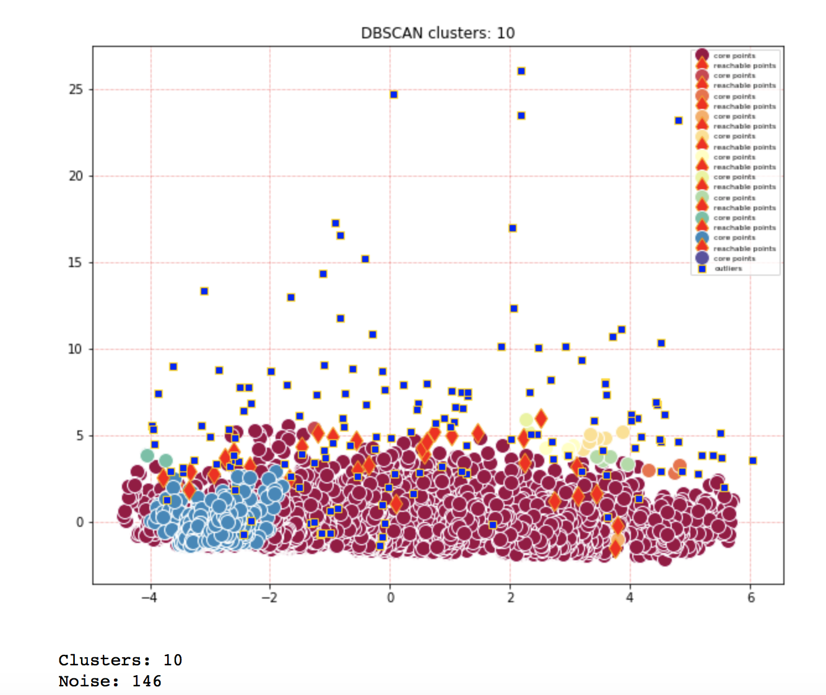
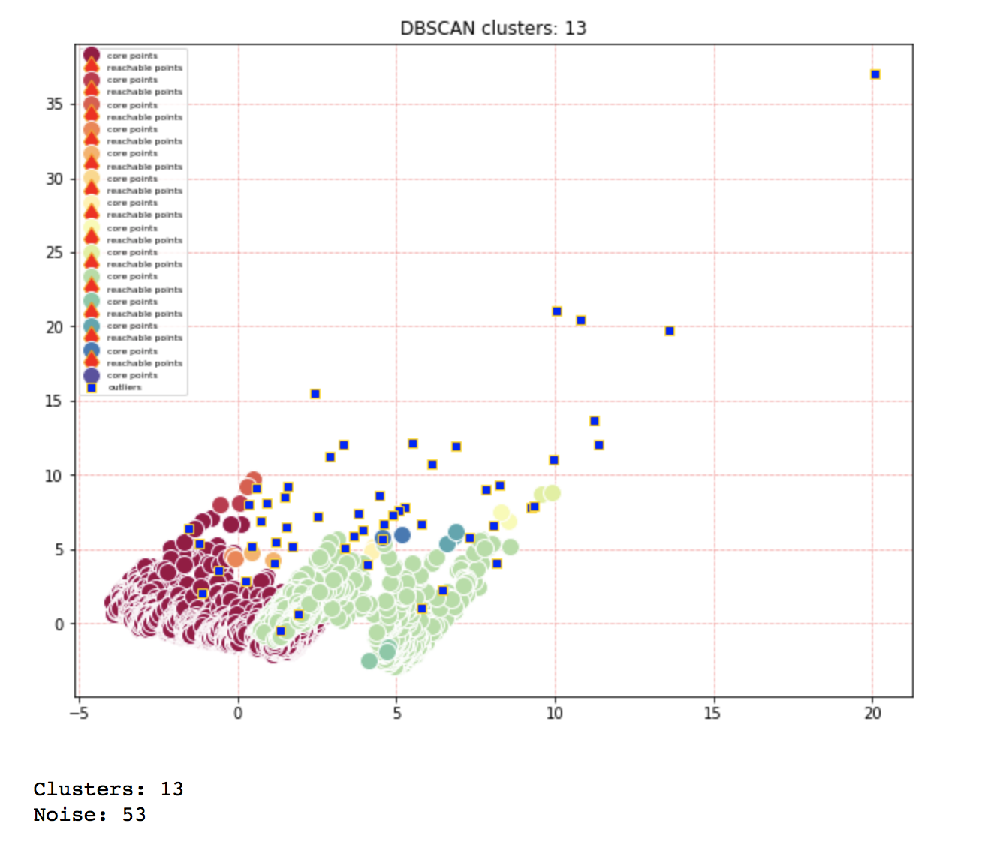
PCA DBSCANs
Top Left-Right : AAPL, AEO
Bottom Left-Right: BAC, WMT

Slide 9
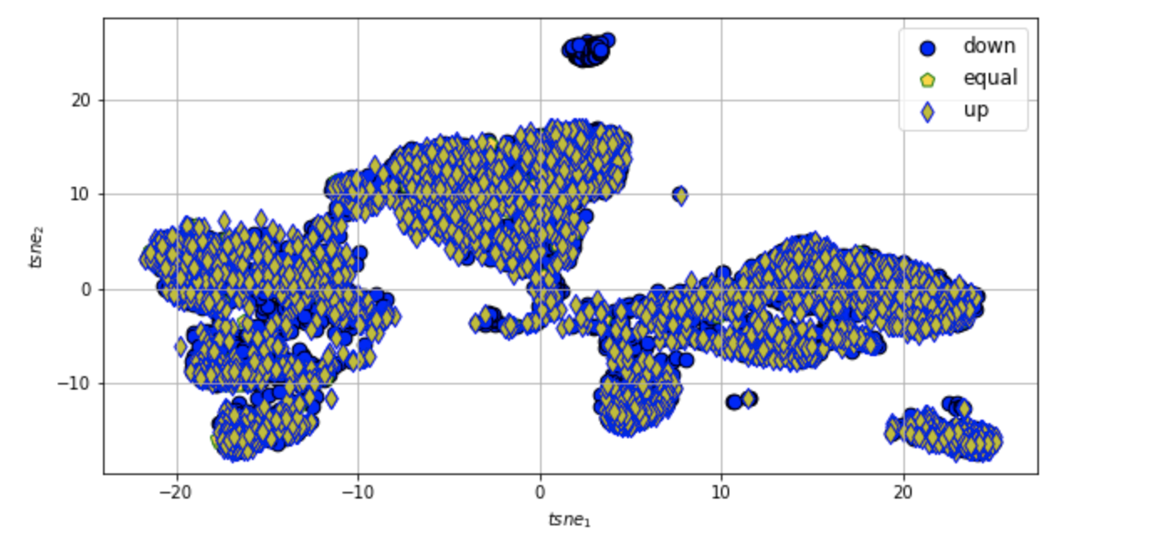
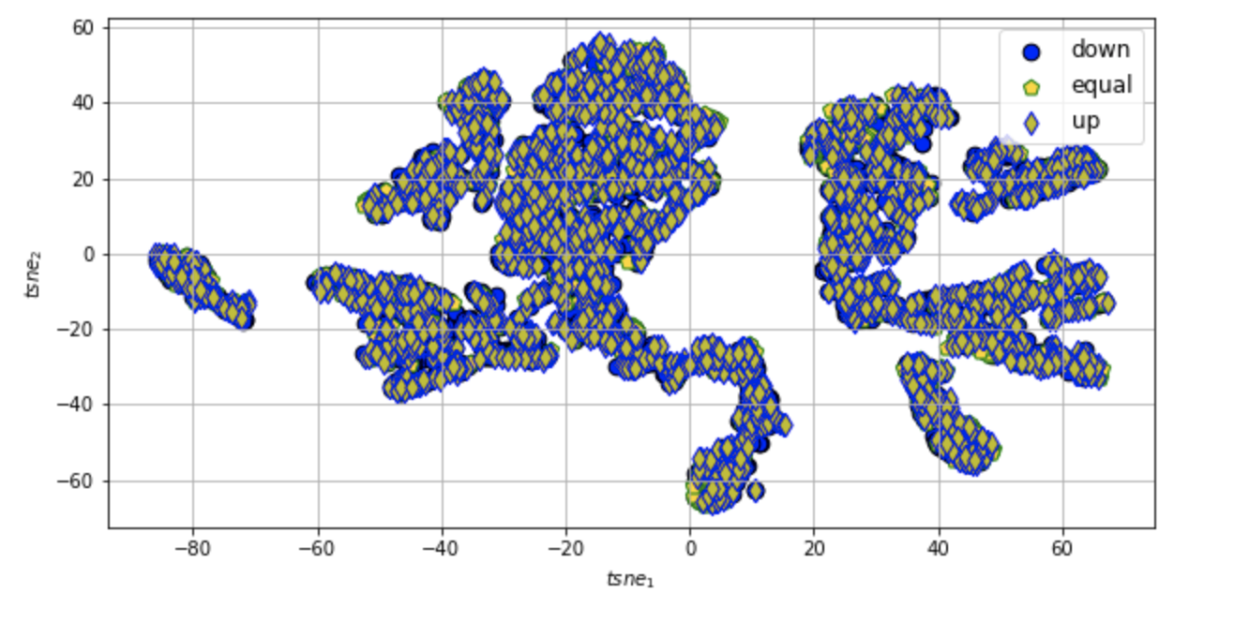
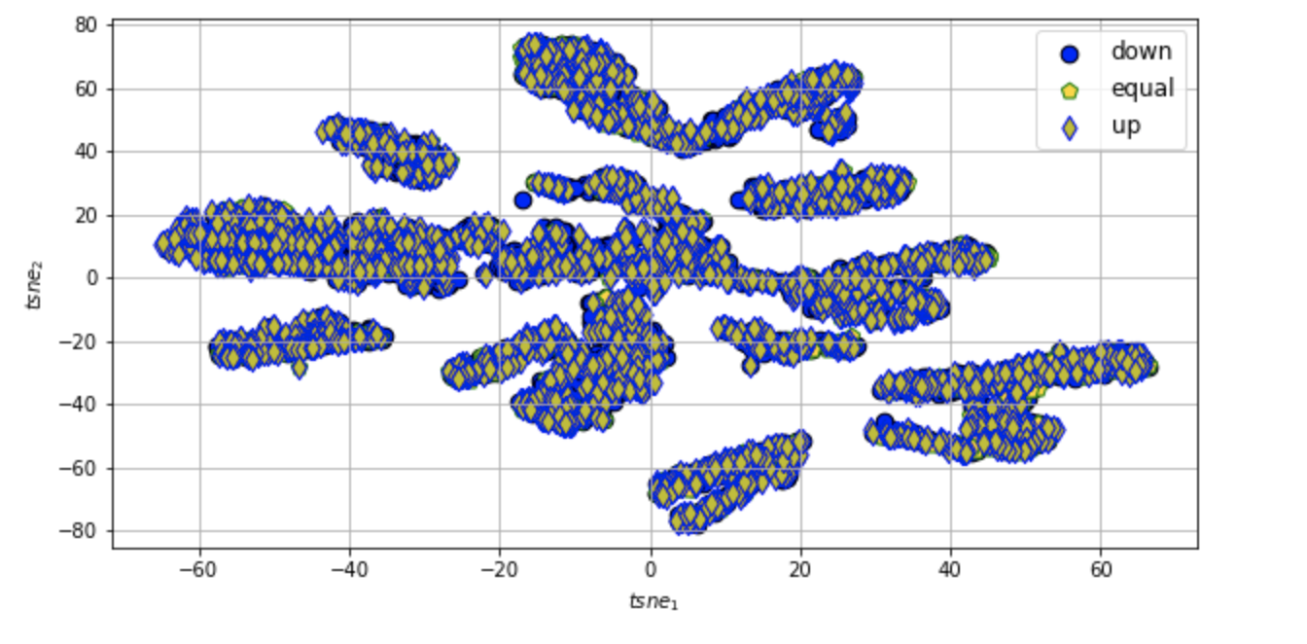
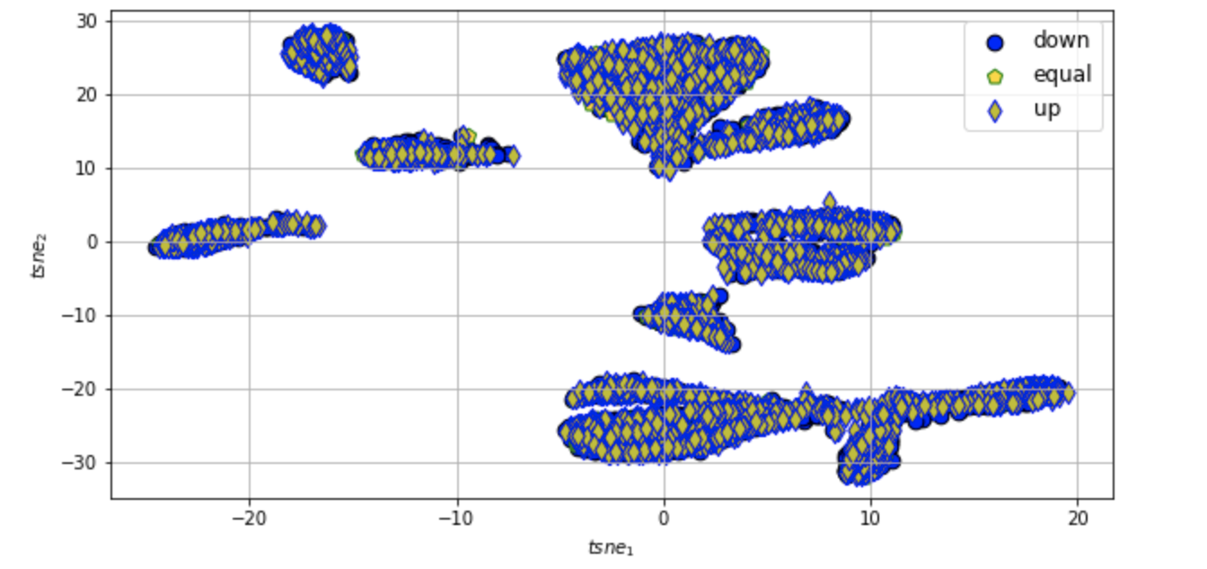
t-SNE Biplots
Perplexity - 350
Perplexity - 50
Top Left-Right : AAPL, AEO
Bottom Left-Right: BAC, WMT
ATM - shown as equal : marketOpen = marketClose OTM- shown as up : marketOpen < marketClose ITM- down : marketOpen > marketClose
Perplexity - 350
Perplexity - 350

Slide 10
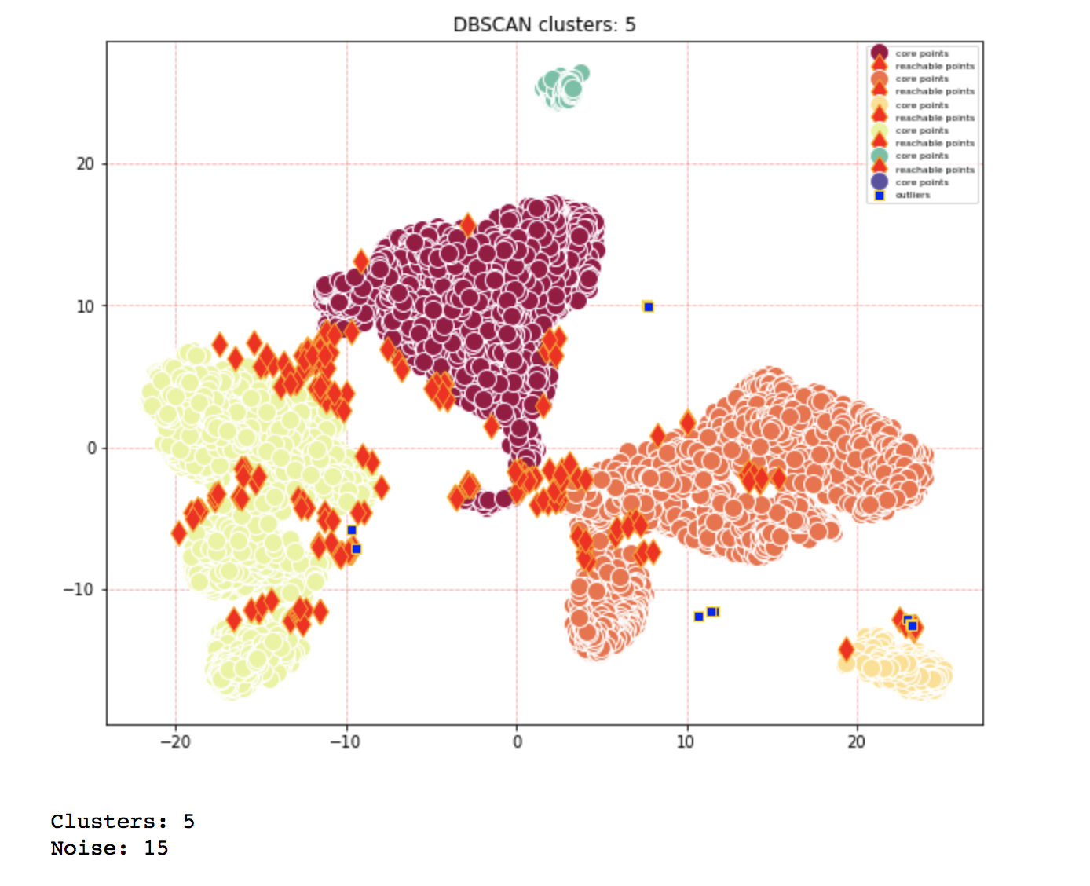
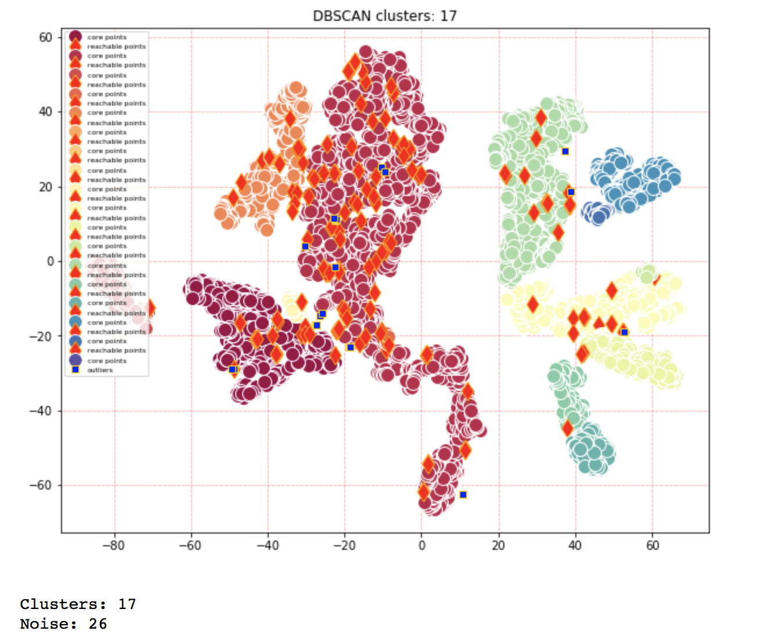
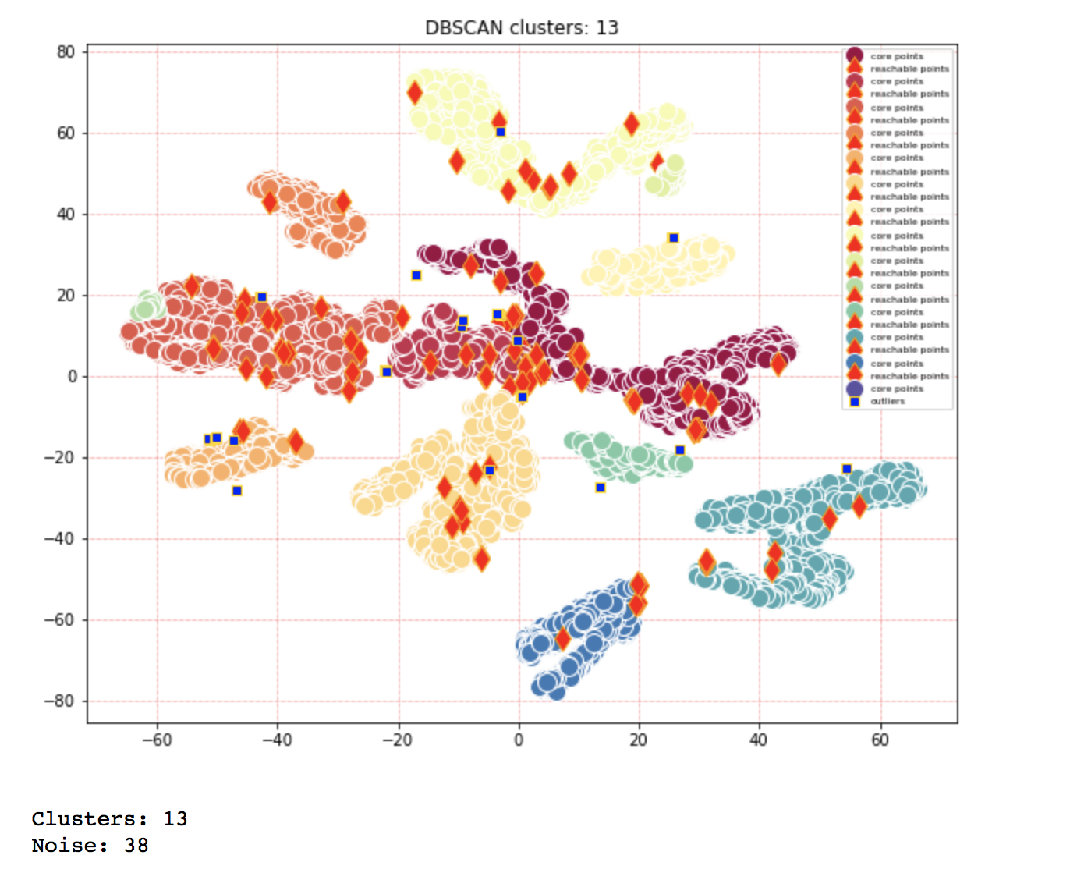
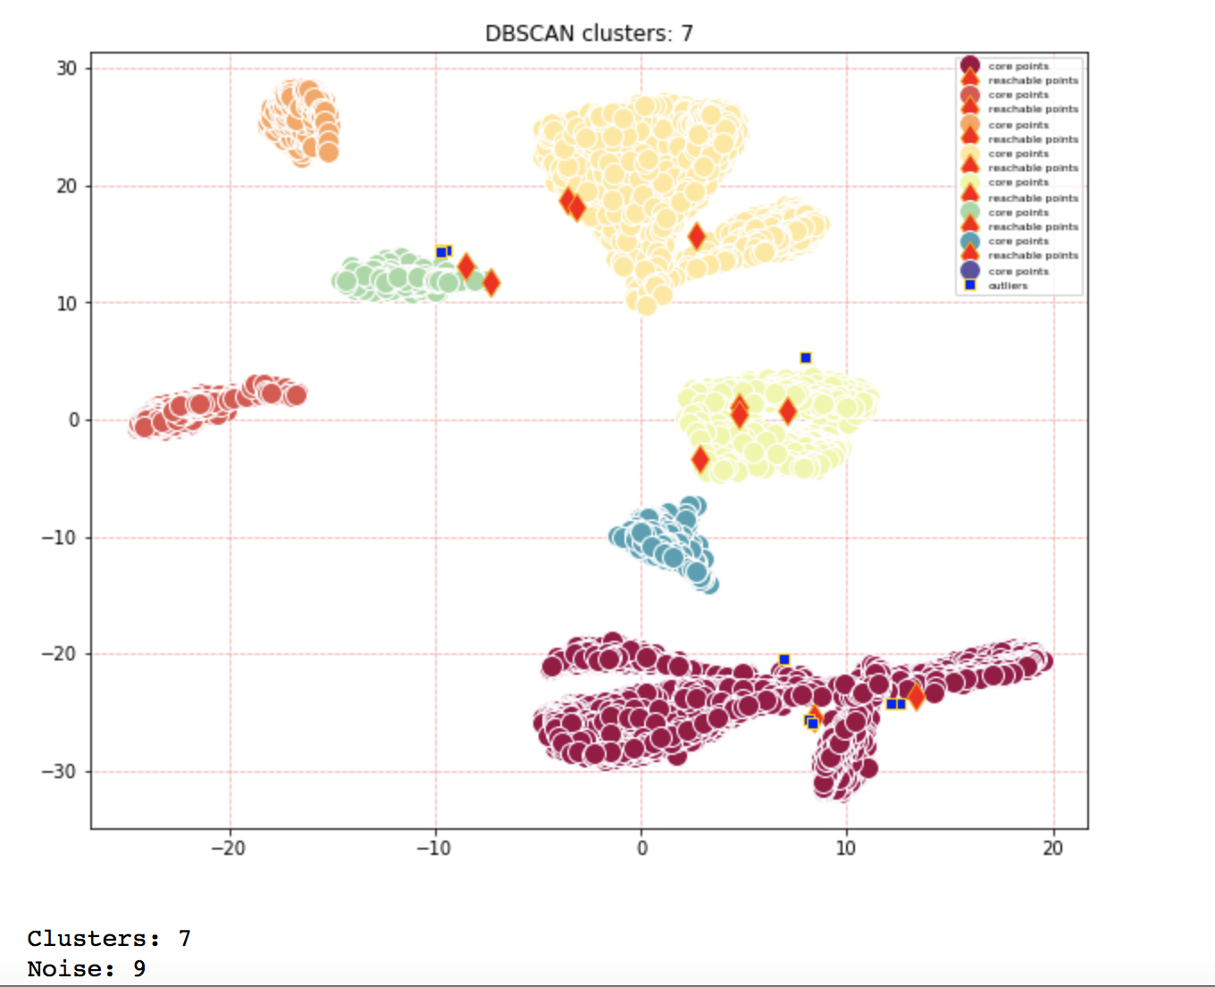
t-SNE DBSCAN
Top Left-Right : AAPL, AEO
Bottom Left-Right: BAC, WMT

Slide 11
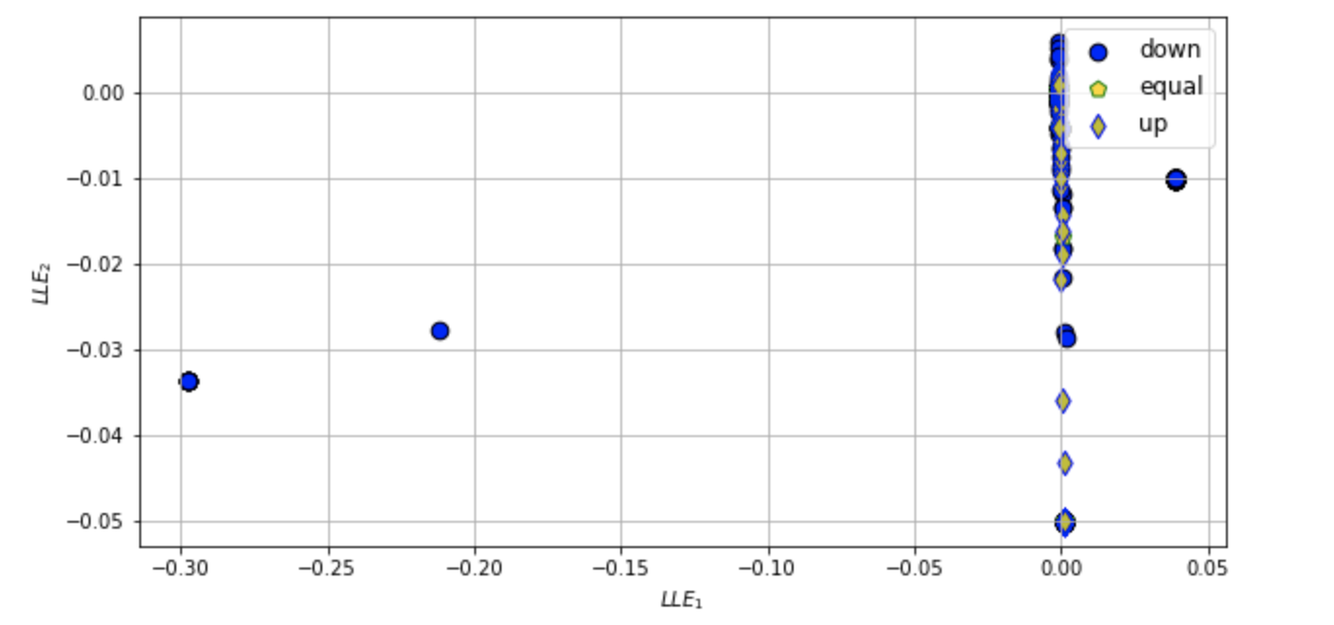
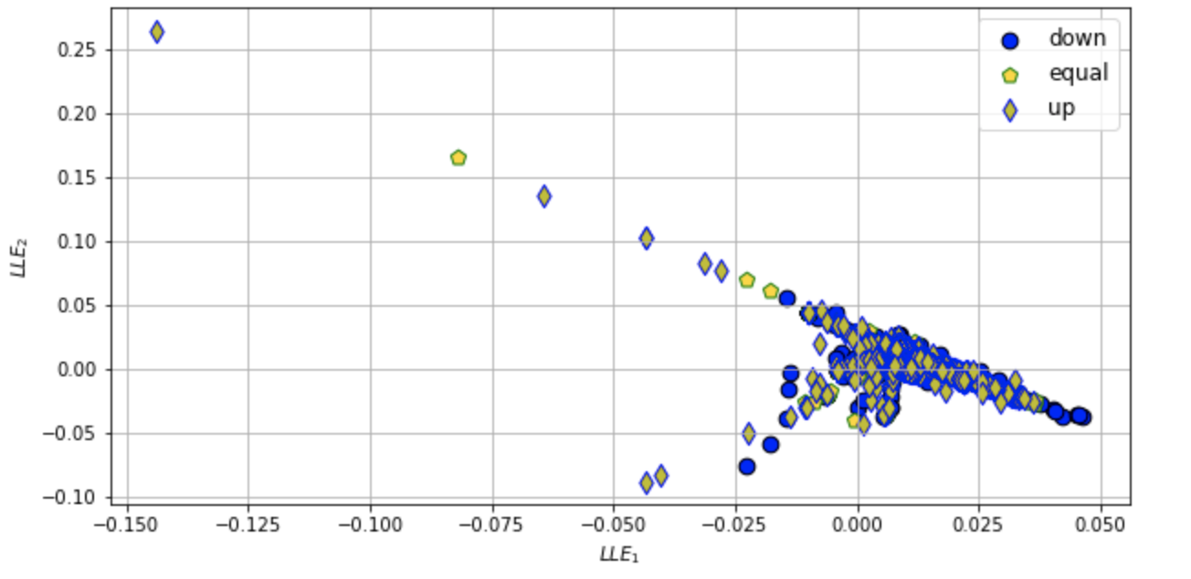
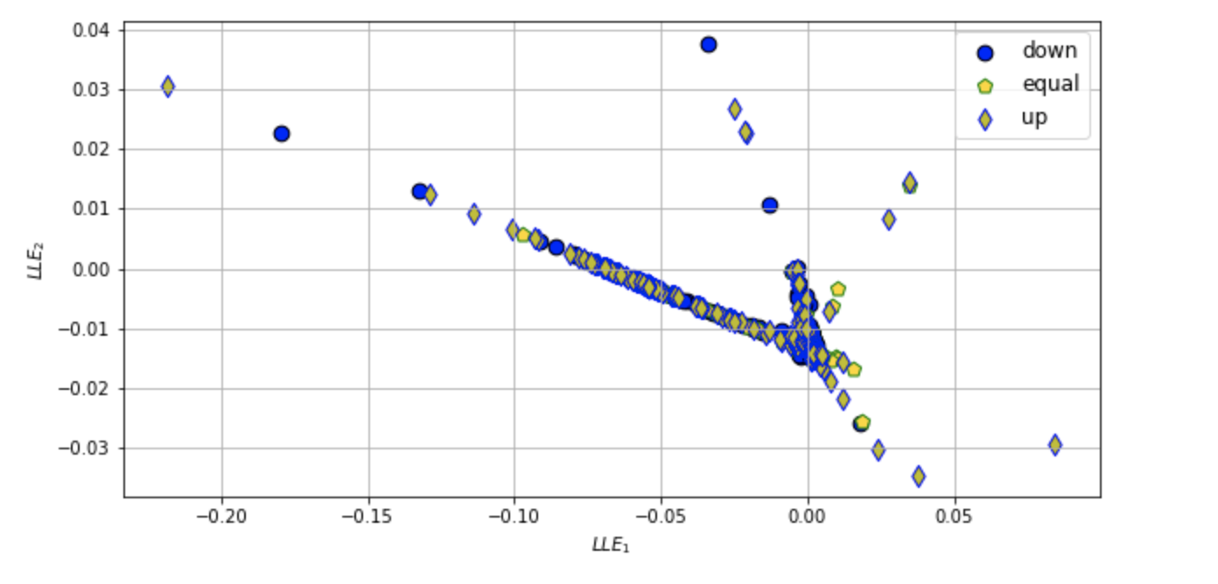
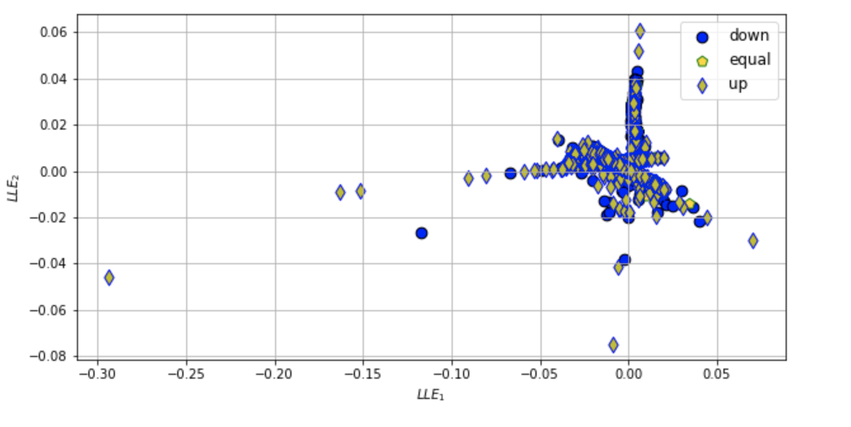
LLE Biplot
Top Left-Right : AAPL, AEO
Bottom Left-Right: BAC, WMT
ATM - shown as equal : marketOpen = marketClose OTM- shown as up : marketOpen < marketClose ITM- down : marketOpen > marketClose

Slide 12
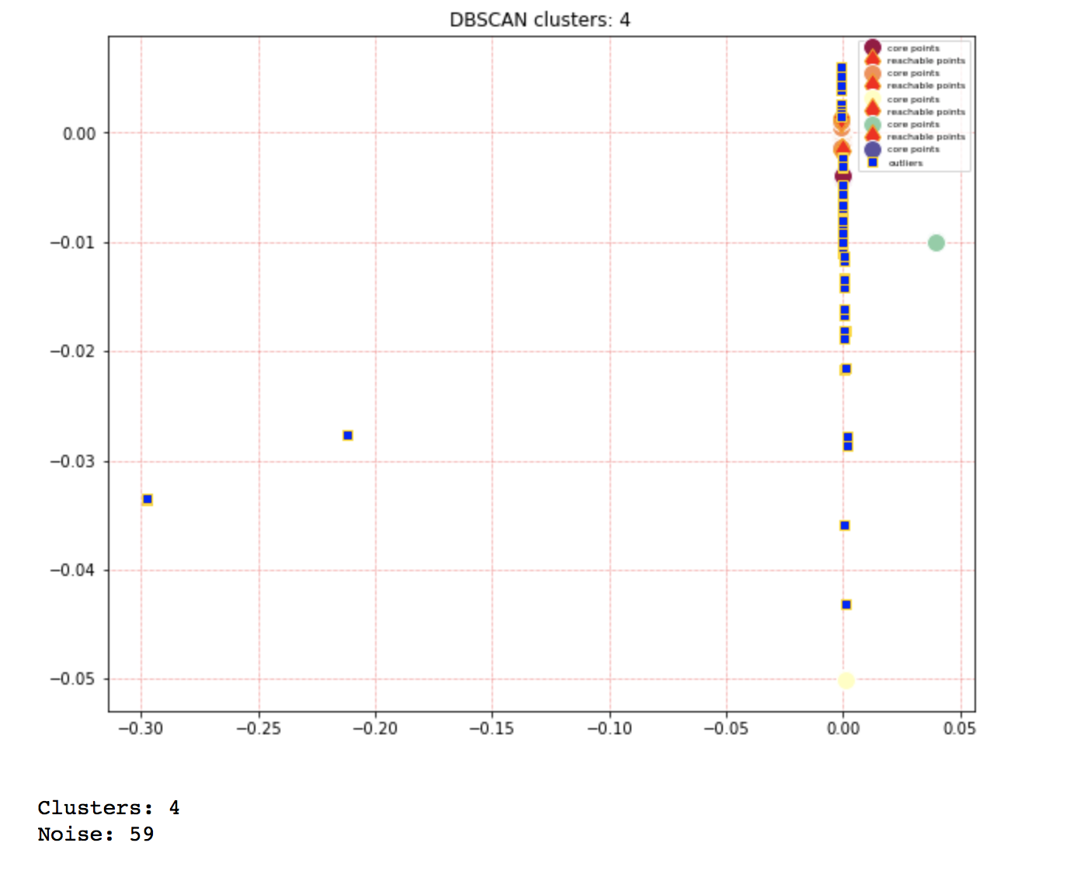
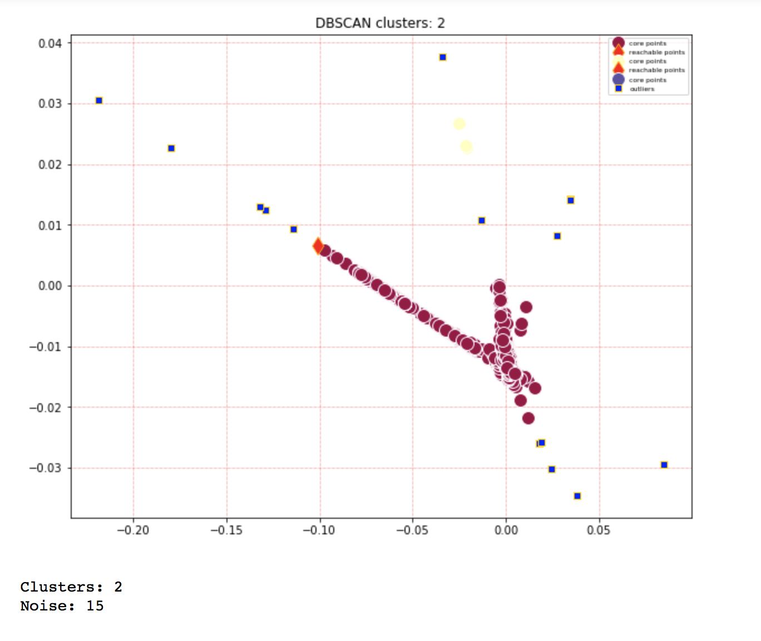
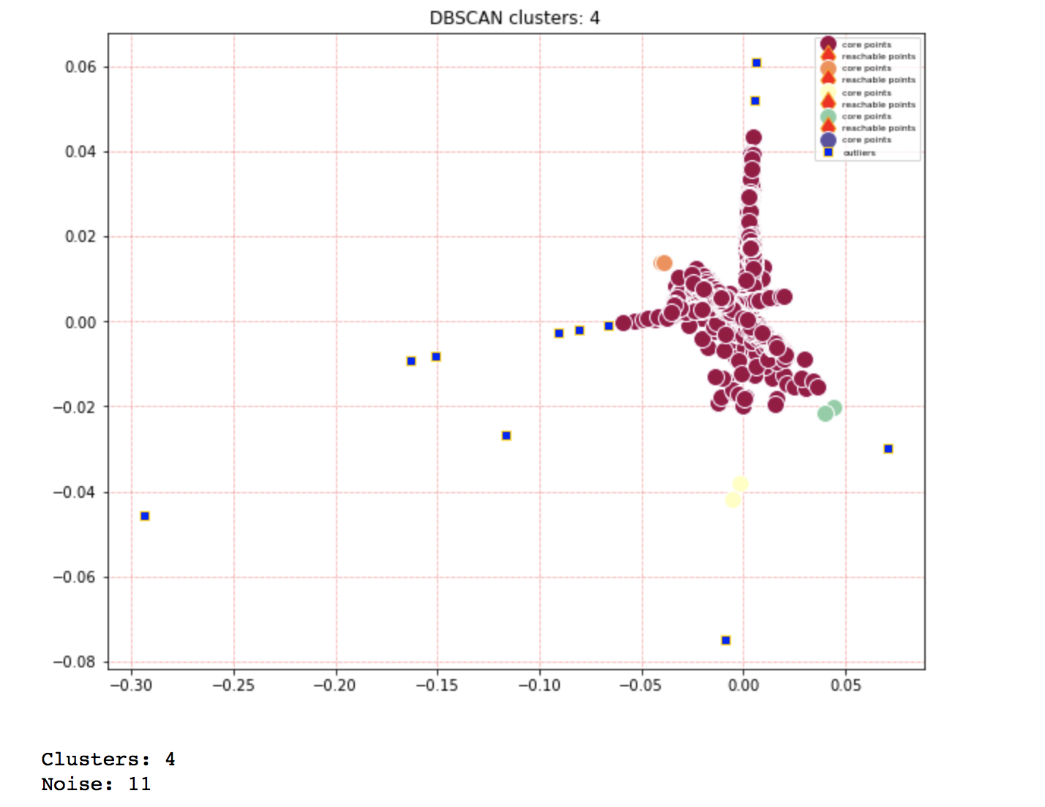
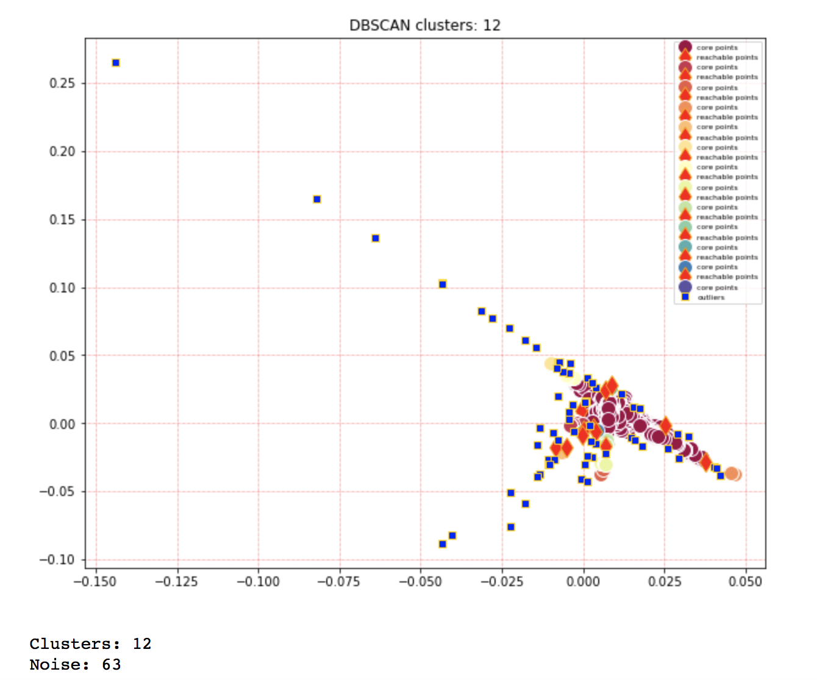
LLE DBSCANs
Top Left-Right : AAPL, AEO
Bottom Left-Right: BAC, WMT

Slide 13
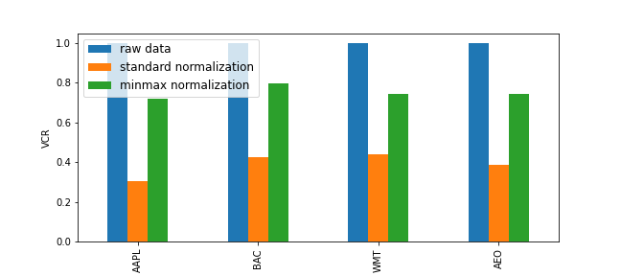
VCR of raw data and corresponding normalized data
StandardScaler removes the mean and scales the data to unit variance.
The scaling shrinks the range of the feature values as shown in the left figure below
MinMaxScaler rescales the data set such that all feature values are in the range [0, 1]
**Both StandardScaler and MinMaxScaler are very sensitive to the presence of outliers.

Slide 14
New Datasets
Three new datasets¹-
Morgan Stanley (MS)
Goldman Sachs (GS)
Nike (nike)
Range - 01/01/2000 - 03/01/2021
¹The datasets are all downloaded from Yahoo finance on 03/20/2021

Slide 15
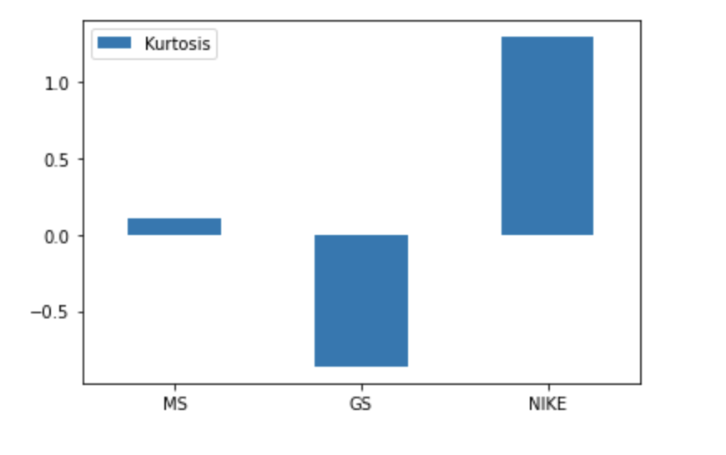
Kurtosis
The Nike dataset has a high kurtosis value relative to the other 2.
But the value is <3- so there should not be abnormally large outliers
Goldman Sachs has the lowest Kurtosis ( < -0.5)

Slide 16
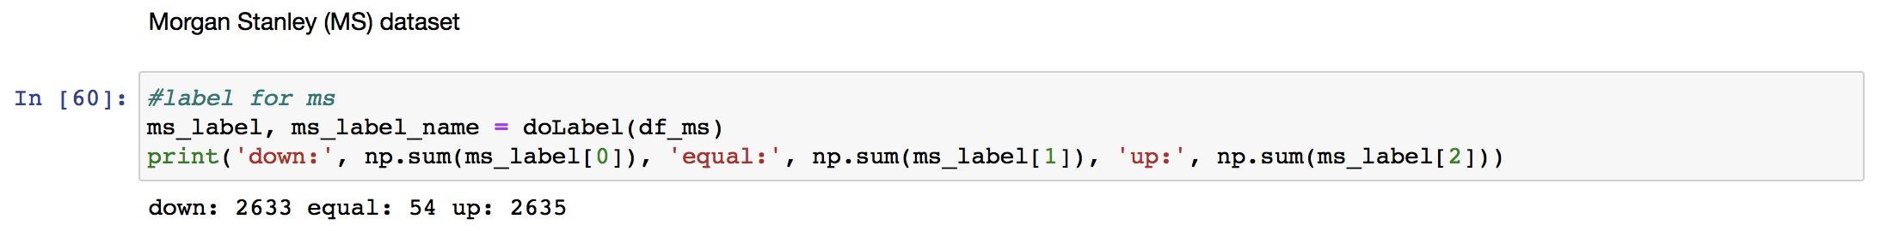
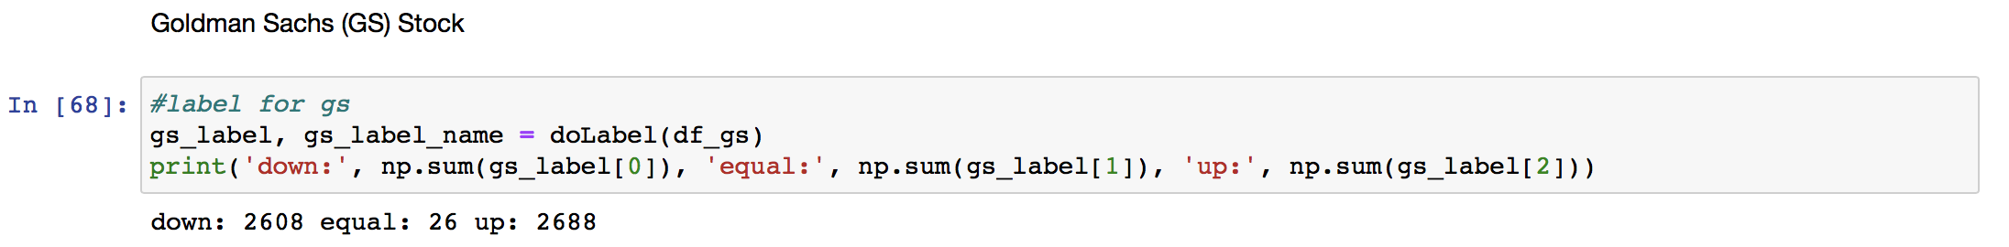
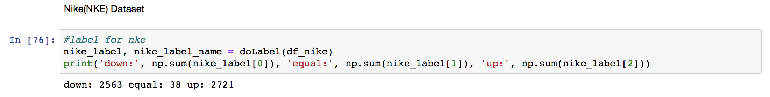
Visualization - Labels for the Biplots

Slide 17
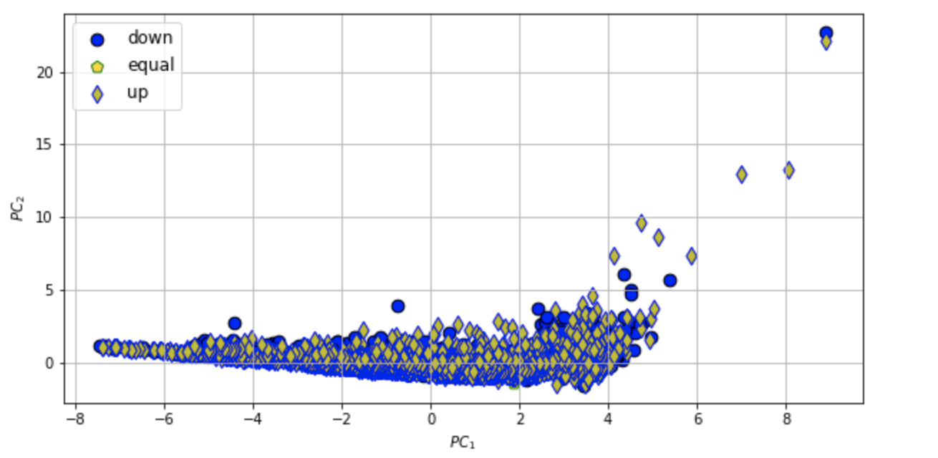
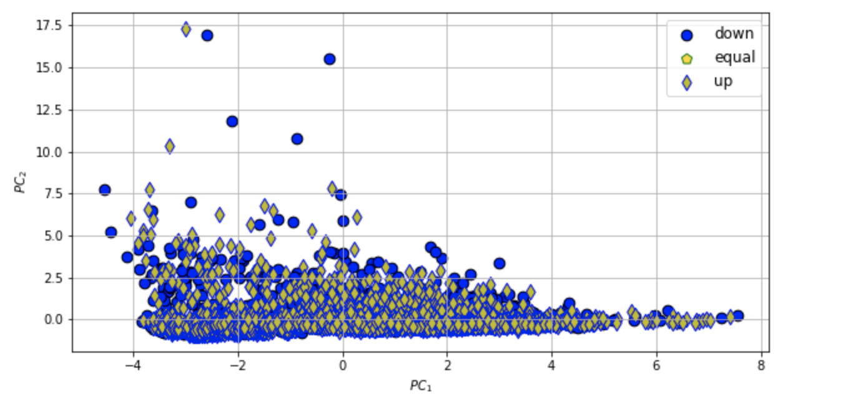
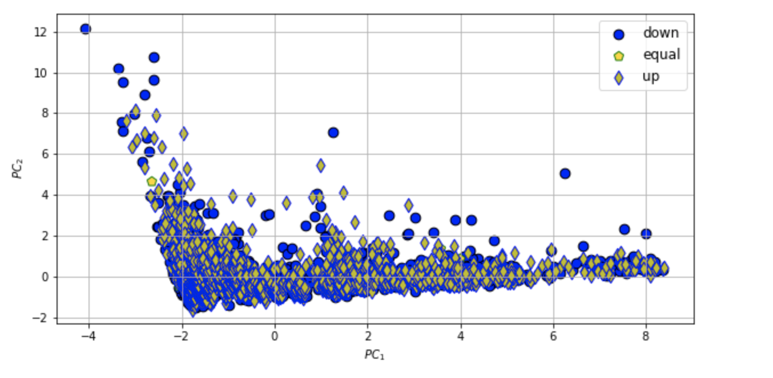
Visualization - Biplots of PCA
Top Left-Right : MS, GS
Bottom: Nike
ATM - shown as equal : marketOpen = marketClose OTM- shown as up : marketOpen < marketClose ITM- down : marketOpen > marketClose

Slide 18
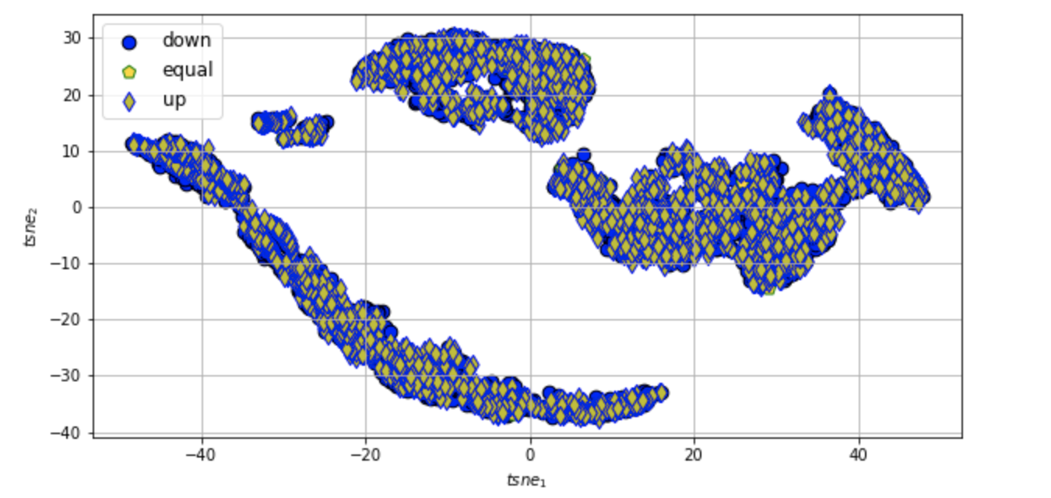
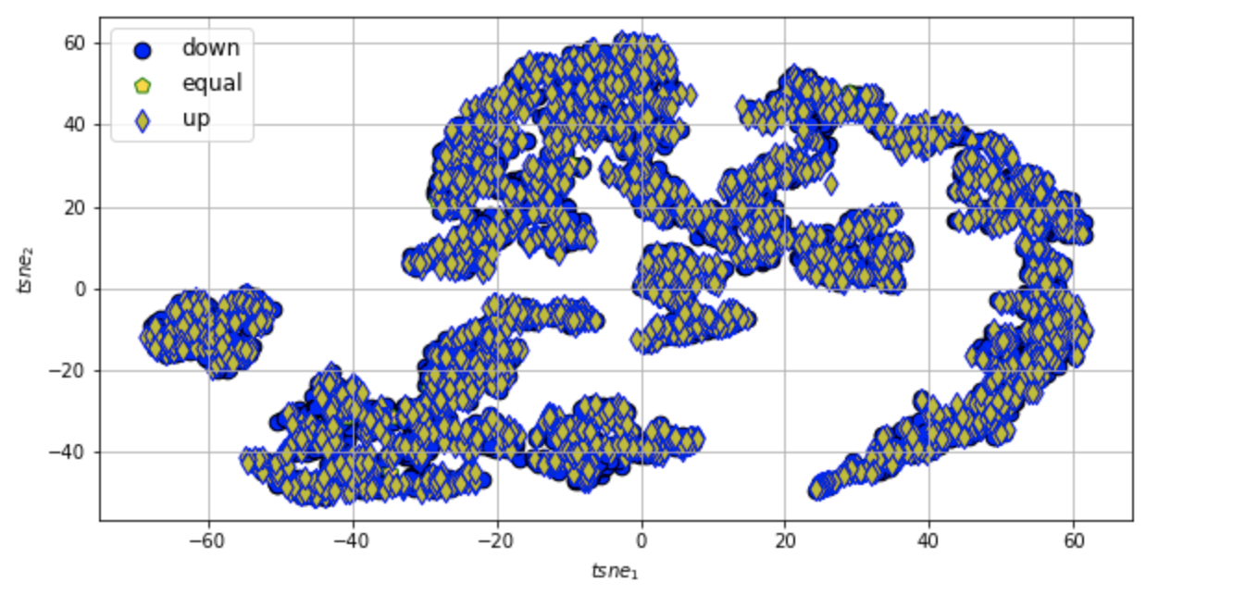
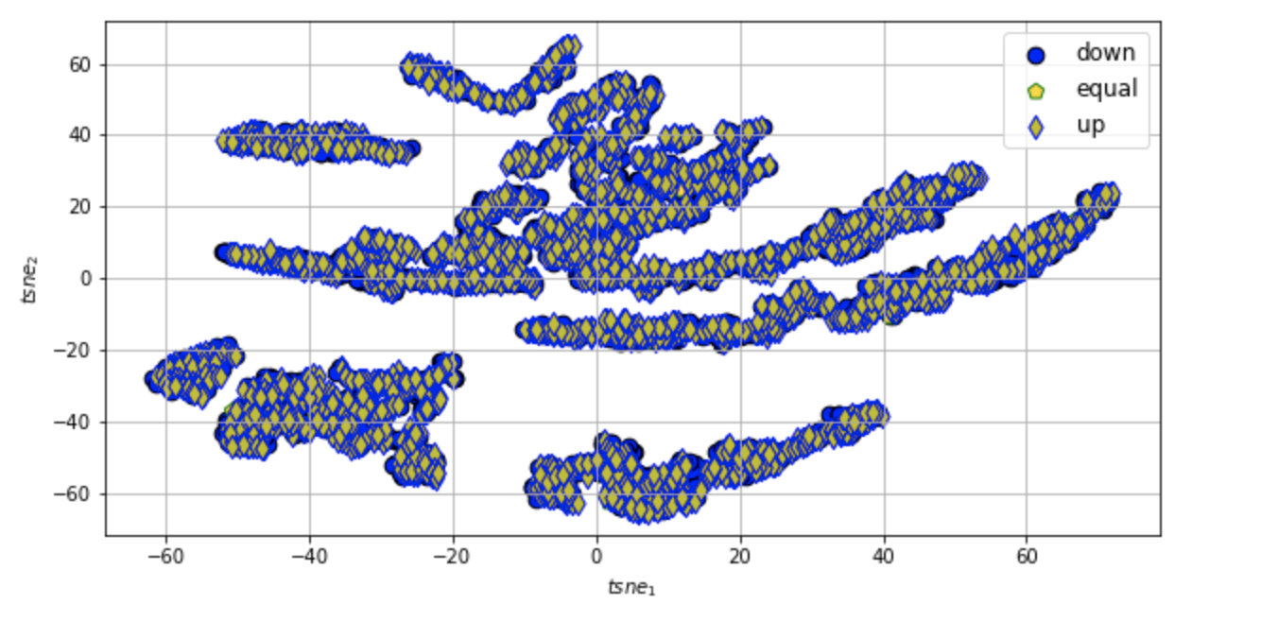
Visualization - Biplots of t-SNE
Top Left-Right : MS, GS
Bottom: Nike
ATM - shown as equal : marketOpen = marketClose OTM- shown as up : marketOpen < marketClose ITM- down : marketOpen > marketClose

Slide 19
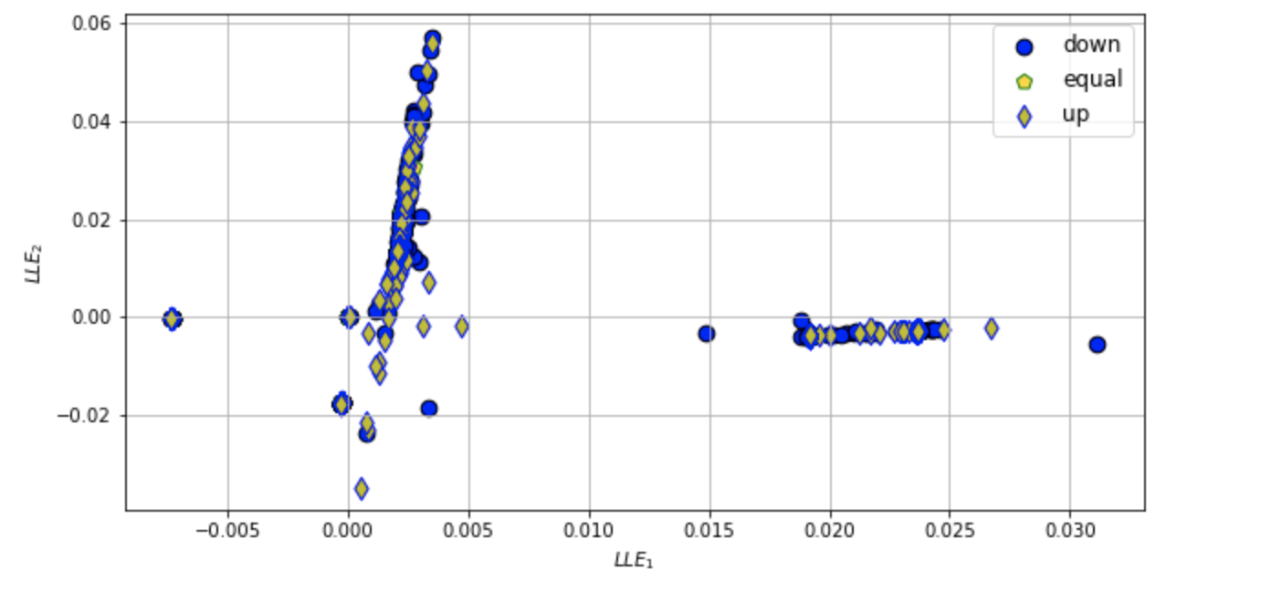
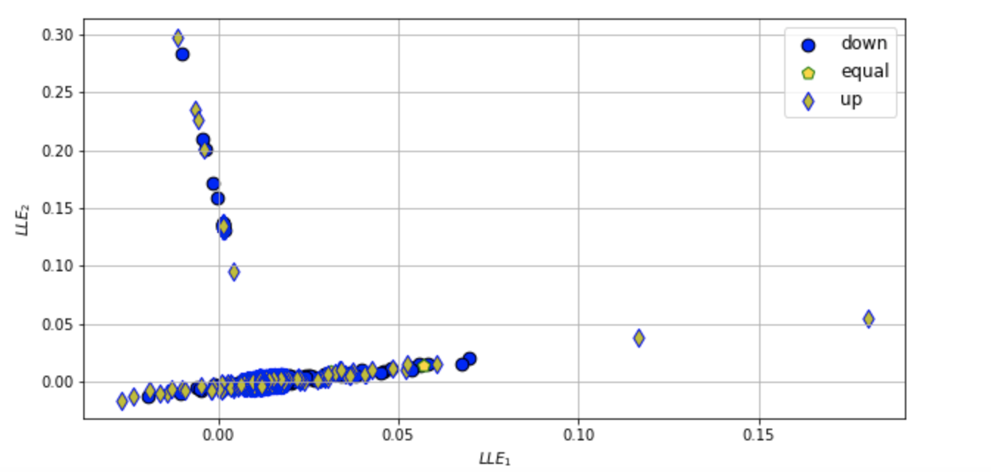
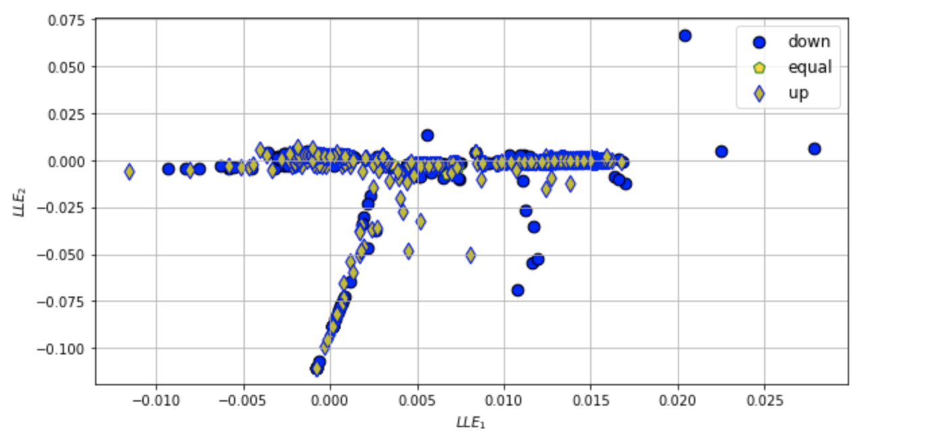
Visualization - Biplots of LLE
Top Left-Right : MS, GS
Bottom: Nike
ATM - shown as equal : marketOpen = marketClose OTM- shown as up : marketOpen < marketClose ITM- down : marketOpen > marketClose

Slide 20
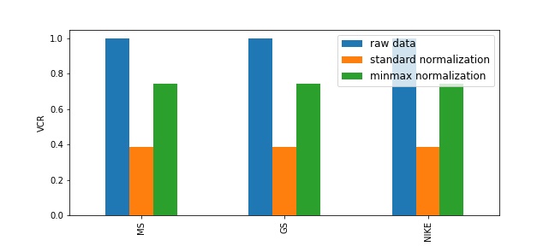
VCR comparison of raw and normalized data

